Slide 1
Creating High-Quality Writing Prompts Foundational Unit 4
Produced Under U.S. Department of Education Contract No. ED-VAE-13-C-0066 With StandardsWork, Inc.
2016

Slide 2
Three Key Advances Prompted by the CCR Standards
Text Complexity: Regular Practice With Complex Text (and Its Academic Language)
Evidence: Reading and Writing Grounded in Evidence From Text
Building Knowledge: Building Knowledge Through Content-Rich Nonfiction
Notes:
Big Idea: These are the most important instructional changes demanded by the CCR Standards for Adult Education.
Facilitator Talking Points:
The key advances represent the most important instructional changes demanded by the CCR Standards for Adult Education.
Key Advance 1: The standards build a staircase of text complexity so that all students are ready for the demands of college- and career-level reading.
Key Advance 2: The standards place a premium on students drawing evidence from texts to support their claims and conclusions about texts.
Key Advance 3: The standards identify reading, researching, and writing about texts as the key to gaining knowledge.
In this unit, we will address the third key advance, BUILDING KNOWLEDGE.
This unit begins with an overview of the rationale for this advance and the implications for instruction.
Facilitator Note: Plan for about 15 minutes to introduce the unit (Slides 1-6).

Slide 3
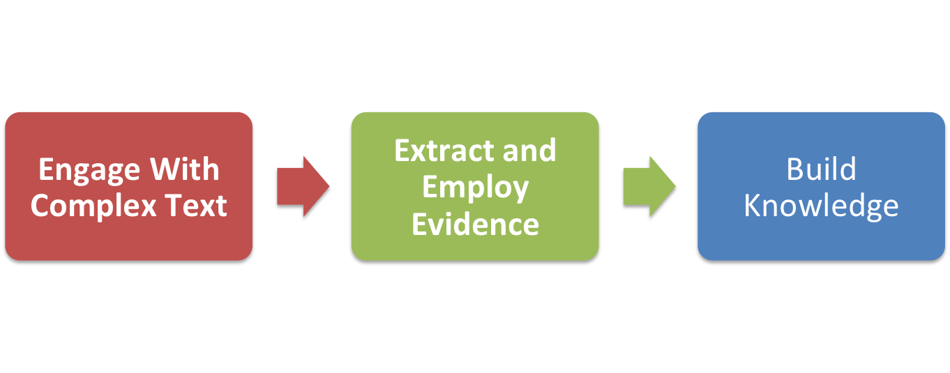
Key Advances Build Toward College and Career Readiness
Notes:
Big Idea: The three advances are connected and build on one another.
Facilitator Talking Point: When students engage with complex text and extract and employ evidence from those texts, they build knowledge about the world, enlarge their experience, and broaden their worldviews.

Slide 4
Unit 4 Objectives Creating High-Quality Writing Prompts
Show how valuable a well-crafted writing prompt can be as a summative learning activity—not just for learning to write but also for reading comprehension and building knowledge.
Learn how to identify and create strong writing prompts.
Notes:
Big Idea: The purpose of this unit is to understand the important role that building knowledge through reading and writing about texts occupies in the CCR Standards.
Facilitator Talking Points:
Having students respond frequently to text-based writing reminds students they are meant to learn from what they read, and it shows students how much they actually have learned from reading.
Asking students to write means students need to return to the text to be academically successful. This exposure reinforces and expands reading comprehension.
Facilitator Notes:
Read these two objectives for Unit 4 aloud and move to the next slide to learn more about the rationale for the unit.
You can pause for questions, but know that most will be answered by continuing with the introductory slide presentation (Slides 1-6).

Slide 5
Rationale for Building Knowledge From Texts
Relevance and Importance Based on the Research
Prior knowledge is a strong predictor of students’ ability to comprehend complex texts. To cultivate their knowledge, students must read and write regularly about content-rich, complex texts. (Hampton and Kintsch)
Writing about what they read improves students’ comprehension of the text (and their writing skills). (Graham and Hebert)
The reading deficit is integrally bound to a knowledge deficit. (Hirsch)
Notes:
Big Idea: Research shows that building knowledge strengthens students’ comprehension.
Facilitator Talking Points:
Comprehension instruction needs to go hand in hand with building knowledge on topics because they reinforce each other. When faced with a complex text, comprehension strategies cannot compensate for a student’s weak domain knowledge.
For deep comprehension to take place, students must connect the information from the printed page with relevant background knowledge stored in their memories.
Growing domain knowledge aids students’ comprehension of future texts; it also builds students’ vocabulary quickly. And asking students to write about what they read is a central method to building students’ knowledge.
5

Slide 6
Implications of Building Knowledge on Instruction
Provide coherent selections of content-rich, strategically sequenced texts so students can build knowledge about a topic.
Always demand evidence in student writing.
Provide well-crafted writing prompts as a summative learning activity, not only to improve writing, but also to strengthen reading comprehension.
Ask students to regularly conduct short, focused research projects and defend their point of view to create a useful and lasting knowledge base.
Notes:
Big Idea: Collecting their thoughts in writing is frequently how people consolidate and display their knowledge.
Facilitator Talking Points:
In instruction, the big shift is to demand evidence in student writing assignments.
A good prompt spurs students to return to the text to synthesize and consolidate their learning.
By requiring a final deep reading of the text, a text-based writing prompt actually strengthens reading comprehension at the same time it assesses their understanding and builds writing skills. Research assignments do the same. Doing both well are hallmarks of college and career readiness.
Facilitator Notes:
Discuss each bullet point with participants. This is about the kinds of texts and the kinds of practices that will build knowledge through reading.
You need to make sure participants understand the link between reading and writing about what they read.

Slide 7
Hands-On Practice
Now let’s do some work identifying
high-quality writing prompts . . .

Slide 8
Materials (Part One)
Directions for Participants
Worksheet: Writing Prompts for The Words We Live By: Your Annotated Guide to the Constitution
Resource: CCR Anchor Standards
Resource: Excerpt from The Words We Live By: Your Annotated Guide to the Constitution
Notes:
Big Idea: Make sure each participant has the correct materials before giving directions for the activity.

Slide 9
Directions (Part One)
Get out your copies of The Words We Live By, CCR Anchor Standards, and the worksheet containing two writing prompts for The Words We Live By.
Work with a partner to determine which prompt is aligned to the CCR Standards and which prompt is not. For each of the two prompts you are examining, ask the questions on the following slide to determine which prompt is stronger.
Notes:
Big Idea: Go over the instructions. They are straightforward.
Facilitator Notes:
Go over all directions before switching to the next slide, which includes the criteria for high-quality writing prompts.
If participants feel more comfortable working as a group at their tables rather than in pairs, allow them to do so.

Slide 10
Guiding Questions
Is the question worth asking?
Does it provide students with an opportunity to explore what they have learned from the text?
Does it ask students to include evidence from the text in their response?
Does the prompt use the language of the CCR Standards where appropriate?
Is the prompt reasonable for the time and energy allotted?
Notes:
Big Idea: These criteria will assist participants in selecting the CCR-aligned prompt.
Facilitator Note: Leave this slide on the screen during the activity.

Slide 11
Directions (Continued)
After you have decided which prompt is the best, use the CCR Anchor Standards to determine which reading, writing, and language standards are embodied in the aligned writing prompt.
Share your results with the group at your table.
Work Session
15 minutes
Notes:
Big Idea: Go over the instructions. They are straightforward.
Facilitator Notes:
If participants feel more comfortable working as a group at their tables rather than in pairs, allow them to do so.

Slide 12
Discussion Questions
What is the value of the text-dependent prompt compared with the other prompt?
What CCR reading, writing, and language standards do you think students would address when working on responses to this prompt?
What changes in current practice might this type of writing require?
Notes:
Big Idea: Get participants to reflect on their choice of writing prompts and the CCR Standards they engage.
Facilitator Talking Points:
Who will share insights about the value of the CCR-aligned prompt compared with the other prompt? (A good prompt demands that the students return to and analyze the text in a way that drives them to identify what they know to be true about what they read. A bad prompt departs from the text and doesn’t demand that students go back and engage deeply with it again.)
Who will identify which CCR Standards they thought students would address while working on responses to this prompt?
The best way to test a prompt is to actually answer (or outline) it yourself to see if it results in the kind of essay you desired. This also allows you to see how long it might take students. While this is tough to ask of busy instructors, it is worthwhile.

Slide 13
Hands-On Practice
Now let’s do some work generating a
high-quality writing prompt . . .

Slide 14
Materials (Part Two)
Directions for Participants
Resource: CCR Anchor Standards
Resource: Eleanor Roosevelt’s Speech to the Members of the American Civil Liberties Union
Resource: Identifying Questions Worth Answering Answer Key for Eleanor Roosevelt’s Speech to the Members of the American Civil Liberties Union
Notes:
Big Idea: Make sure each participant has the correct materials before giving directions.

Slide 15
Directions (Part Two)
Read the Roosevelt text and the high-quality, text-dependent questions written for it.
Use the essential understanding or central idea identified to begin framing the prompt. A great prompt should get students to their own grasp of that essential understanding.
Discuss possible prompts with your partner(s).
Examine the CCR Anchor Standards for reading and writing to determine which standards you want to have students focus on in fulfilling this prompt.
Notes:
Big Idea: Generating good writing prompts takes close and careful consideration of the text(s) they are tied to.
Facilitator Notes:
The questions from the answer key for the Roosevelt speech that have an asterisk are those that require students to read the speech more deeply to answer them.
Generating CCR-aligned writing prompts is challenging work.

Slide 16
Directions (Continued)
Agree on and write a prompt. Discuss whether it will produce writing for building an argument (CCR Writing Standard 1) or explanatory or informative writing (CCR Writing Standard 2) and label it.
Discuss the prompts you and your colleagues developed, and determine which of them best meets the criteria on the following slide.
Work Session
45 minutes
Notes:
Big Idea: Continue going over the instructions.
Facilitator Notes:
Check in with the whole group to make sure all instructions are clearly understood before turning the room over to participants.
Leave the Criteria for High-Quality Writing Prompts slide (next) on the screen during the activity.

Slide 17
Criteria for High-Quality Writing Prompts
Require students to gather, organize, and present evidence from what they read.
Expect students to return to the text.
Use the language of the CCR Standards where appropriate.
Give writers an opportunity to explore what they learned from the text.
Require an exploration of the most essential ideas from the text.
Are reasonable in terms of the time and energy allotted to students to complete the task.
Notes:
Big Idea: These criteria will assist participants in generating a CCR-aligned writing prompt.
Facilitator Note: Leave this slide on the screen during the activity.

Slide 18
Reflections
Are any volunteers willing to share their writing prompt?
What makes a good prompt?
What changes in current practice might this type of writing require?
15 minutes
Notes:
Big Idea: Get participants to reflect on why asking students to respond to CCR-aligned writing prompts is a powerful tool in building knowledge.
Facilitator Talking Points:
Who will share your prompt and tell us what standards you tied to it?
Who will share your insights about the value of high-quality, text-dependent writing prompts?
What makes a good prompt?
A good prompt demands that students return to analyze the text in a way that drives them back to the text.
A bad prompt departs from the text or doesn’t demand that students go back and engage deeply with it again.
Writing, or even identifying, a good prompt is much more difficult than it might seem initially because it asks the creator to have a strong grasp of the reading. When instructors are busy, this can easily fall to the wayside if it is not nurtured through professional training opportunities and practice.
The best way to test a prompt is to actually answer (or outline) it yourself to see if it results in the kind of essay you desired. This also allows you to see how long it might take students. While this is tough to ask of busy instructors, it is worthwhile.

Slide 19
Next Steps
How has participating in this activity changed your thinking about the CCR Standards?
How will you use the information and understanding you have acquired to improve your teaching practice and student learning?
What additional training and tools would strengthen your ability to do so?
Notes:
Big Idea: Ask participants to discuss what they have learned and to think ahead about how they plan to use what they have learned.

